Slide 1
TOPIC 2: CORRELATIONS AND SCATTER GRAPHS
Correlation is the relationship between two variables. The measure of the degree of the relationship between two variables is the correlation coefficient
Scatter graphs
is a graphical representation of two variables for a given set of data
Types of correlation
a) positive / direct correlation: if one variable,x, increases the other, y, increases also
b) negative/ inverse correlation: if one variable,x, increases as y decreases or as x reduces variable, y, increases
c) zero/no correlation: if an increase or decrease in one variable does not affect the other ,then the variables are said to have no correlation.

Slide 2
#

Slide 3
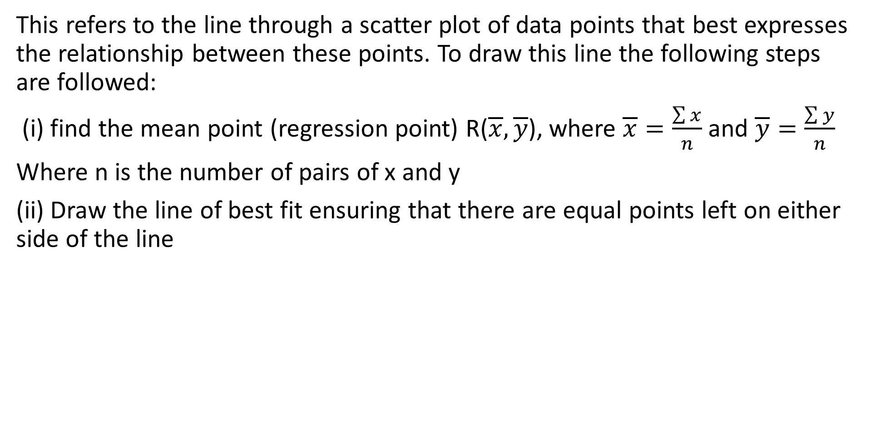
Line of best fit
This refers to the line through a scatter plot of data points that best expresses the relationship between these points. To draw this line the following steps are followed:
(i) find the mean point (regression point) R($\overline{x},\overline{y}$), where $\overline{x}=\frac{\sum{x}}{n}$ and $\overline{y}=\frac{\sum{y}}{n}$
Where n is the number of pairs of x and y
(ii) Draw the line of best fit ensuring that there are equal points left on either side of the line

Slide 4
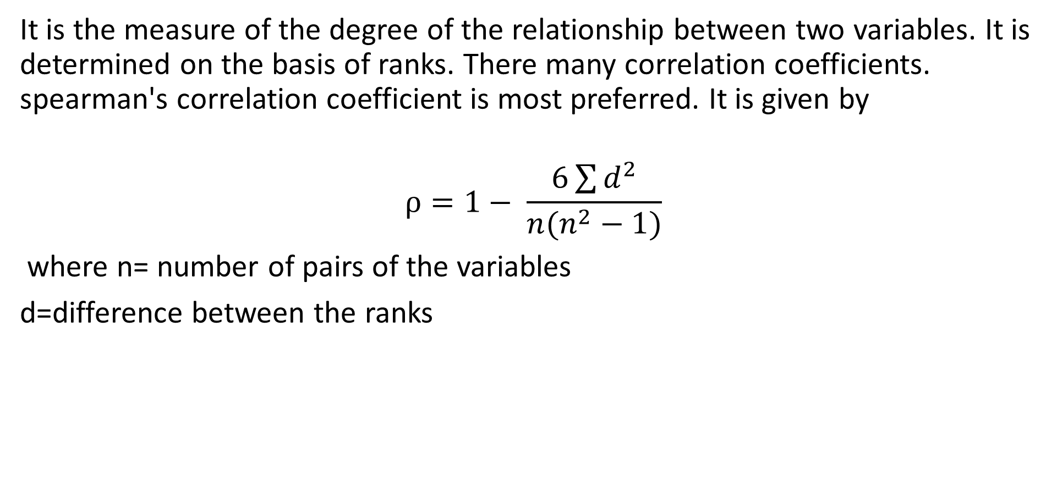
Rank correlation coefficient
It is the measure of the degree of the relationship between two variables. It is determined on the basis of ranks. There many correlation coefficients. spearman's correlation coefficient is most preferred. It is given by
$$ρ=1− \frac{6\sum{d^{2}}}{n(n^{2}−1)}$$
where n= number of pairs of the variables
d=difference between the ranks

Slide 5
Interpretation of magnitude of correlation coefficient
a) Using magnitude and direction
NOTE: 1. the correlation coefficient lies btn -1 and +1. values btn -1 and 0 indicate negative correlation and values btn 0 and +1 indicate positive correlation.
Correlation coefficient | interpretation
0 | No correlation
0 – 0.19 | Chance correlation
0.2- 0.39 | Slight/ weak correlation
0.4 – 0.59 | Moderate correlation
0.6 – 0.79 | Substantial correlation
0.8 – 0.99 | Strong /high correlation
1 | Perfect correlation

Slide 6
2. In interpreting correlation coefficients, we consider 2 factors;
Sign of correlation coefficient
Magnitude of correlation coefficient
The sign tells us whether the variables have a positive or negative correlation and the magnitude tells us the degree of the correlation
Examples
The boys compete in throwing a ball and the a table below shows the heights of each boy and the distances to which he can throw the ball
Heights(cm) | 122 | 124 | 133 | 138 | 144 | 156 | 158 | 161 | 164 | 168
Distance(m) | 41 | 38 | 52 | 56 | 29 | 54 | 59 | 61 | 63 | 67

Slide 7
a)Calculate the rank correlation coefficient and give a comment on your results
b) Draw a scatter diagram for the above data, obtain a line of best fit and use it to estimate;
The distance thrown by a boy of height 135cm
the distance thrown by a boy of height 162cm

Slide 8
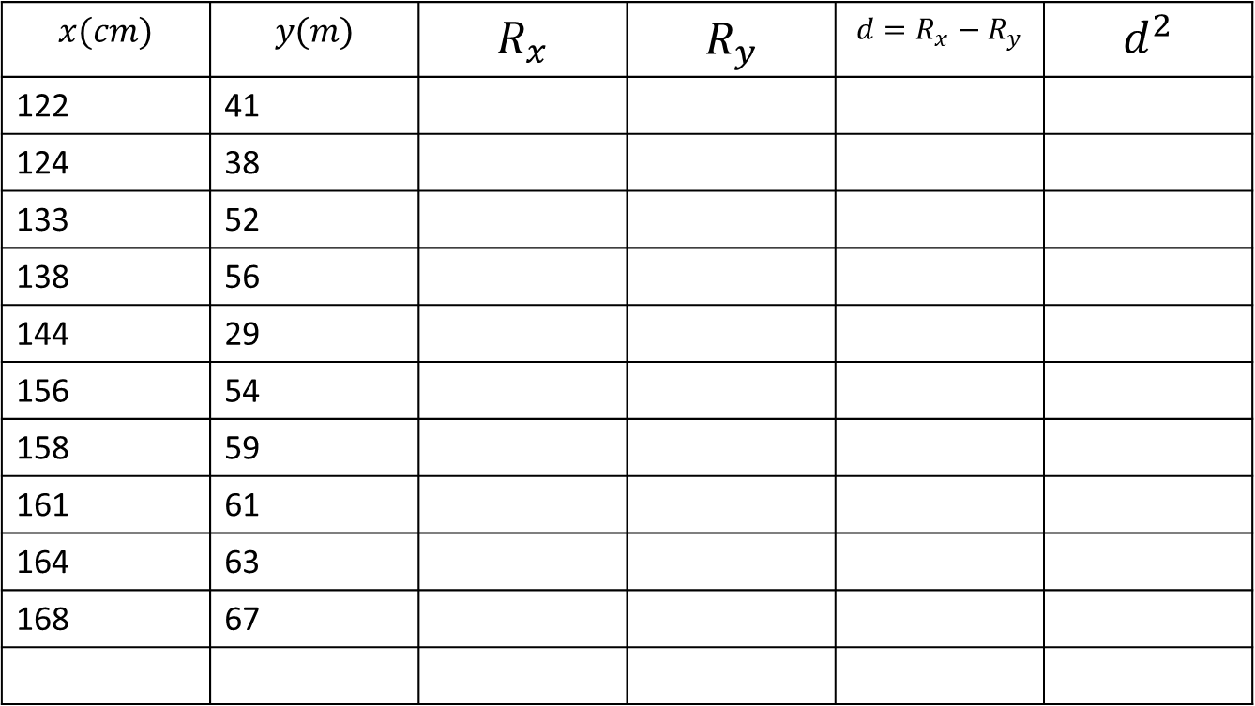
solution
Let the heights be x and the distance be y
$$x(cm)$$ | $$y(m)$$ | $$R_{x}$$ | $$R_{y}$$ | $$d=R_{x}−R_{y}$$ | $$d^{2}$$
122 | 41
124 | 38
133 | 52
138 | 56
144 | 29
156 | 54
158 | 59
161 | 61
164 | 63
168 | 67

Slide 9
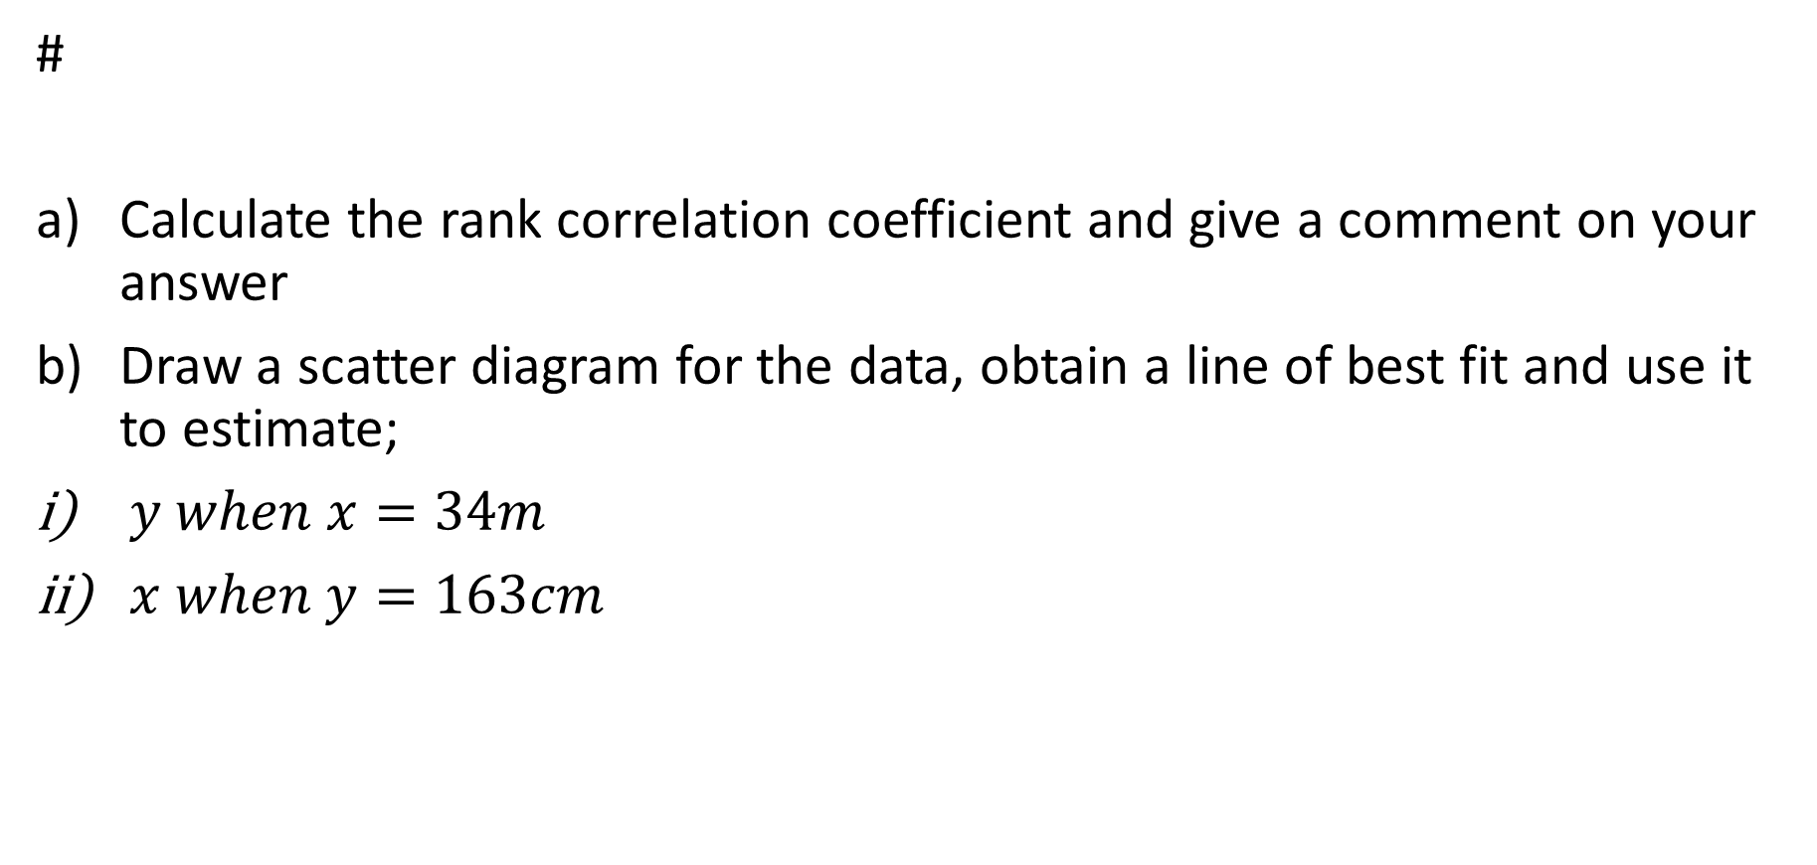
2. The table below shows values of $x and y$
#
Calculate the rank correlation coefficient and give a comment on your answer
Draw a scatter diagram for the data, obtain a line of best fit and use it to estimate;
$y when x=34m$
$x when y=163cm$
$$x(m)$$ | 27 | 30 | 37 | 38 | 32 | 38 | 42 | 36 | 44 | 33 | 38 | 36 | 32 | 32
Y(cm) | 118 | 136 | 156 | 150 | 140 | 144 | 159 | 149 | 170 | 131 | 160 | 155 | 157 | 114

Slide 10
solution
#
X (m) | Y(cm)
27 | 118
30 | 136
37 | 156
38 | 150
32 | 140
38 | 144
42 | 159
36 | 149
44 | 170
33 | 131
38 | 160
36 | 155
32 | 157
32 | 114

Slide 11
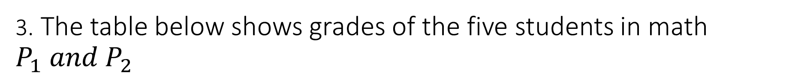
3. The table below shows grades of the five students in math $P_{1} and P_{2}$
#
Calculate the rank correlation coefficient and comment on your answer
PAPER 1 | PAPER 2
C3 | D2
C3 | C5
D2 | D1
D1 | D2
C5 | D2

Slide 12
4.The table below shows the performance of 7 students in maths and physics
Calculate the rank correlation coefficient and comment on your answer
mathematics | Physics
A | C
B | B
D | A
E | D
C | A
F | E
D | B

Slide 13
Exercise
The table below shows the grades scored by students in physics and chemistry at TISS
Calculate the rank correlation coefficient and comment on your answer
2. The table below shows the scores of 6 students in chemistry and biology
Calculate the rank correlation coefficient and comment on your results
Chem | D2 | C5 | D2 | C5 | C4 | C3 | D2 | D1
Phy | D1 | C4 | D1 | C5 | D2 | C3 | C5 | C3
Chem | E | C | B | F | D | A
Bio | F | A | D | E | C | C

Slide 14
3. The performance of 10 students in maths and physics are given in the table below.
#
Calculate the rank correlation coefficient and give a comment on your answer
4. The table below shows the grades of 10 students in physics and economics
Calculate the rank correlation coefficient and comment on the performance between physics and economics
Math | A | B | C | D | E | A | C | E | B | B | C
Phy | B | A | C | D | E | B | B | D | E | C | D
Phy | A | B | C | E | B | F | D | A | O | A
Econ | C | D | C | A | O | E | D | A | F | B

Slide 15
5. The table below shows the scores in math and economics for 11 students
#
Plot the scatter diagram for the data, obtain the line of best fit and hence estimate the economics marks for a student who scored 77 from math
Calculate the rank correlation coefficient and comment on the performance of students between physics and economics
Math | 82 | 78 | 86 | 72 | 91 | 80 | 95 | 72 | 89 | 74 | 95
Econ | 75 | 80 | 93 | 65 | 87 | 71 | 96 | 68 | 84 | 77 | 80

Slide 16


6. The table below shows how 6 students were graded in physics and maths
#
Calculate the rank correlation coefficient. Comment on your results
The table below shows the concentration of roots of a certain tree with respect to depth
Calculate the rank correlation coefficient. Comment on your result

Slide 17
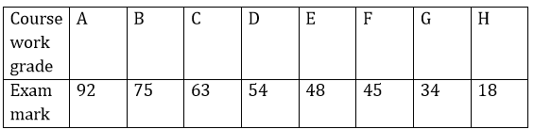
8. The course work grades ranging from A to H and examination marks of 8 candidates are given below
#
Calculate the spearman’s rank correlation coefficient between the two sets of data
Test whether it is significant at 5% level

Slide 18
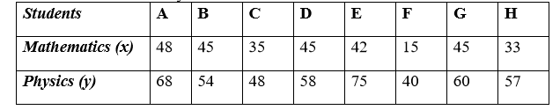
9. The table below scores by candidates in ICT and mathematics
#
Calculate the spearman’s rank correlation coefficient for the above data
Test whether the correlation is significant at 5% level of significance
10. Eight students participated in an examination for math and physics

Slide 19

Calculate: (i) the rank correlation coefficient (ii) comment on 1% level of significance
11. The table below gives the marks scored by eight students in two sets of mocks 1 and 2
Calculate the rank correlation coefficient between the performance of the two set mocks and hence comment on your results

Slide 20

12. The table below shows the mock examination marks and A level grades obtained by students in a certain year
#
Calculate the rank correlation coefficient of the performance of students. Comment on your results
13.The table below presents the quantity demanded of a commodity, Y, (units) and customer income,X, (ug shs) from 2008 to 2020 in Wakiso district

Slide 21
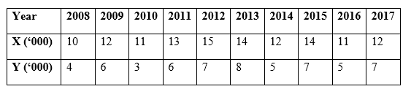
a) Plot a scatter graph for the above data and comment on your results
b) Draw a line of best fit and use it to estimate;
Quantity demanded when the customer income was 7500/=
Income needed to purchase 9000 units
c) Calculate the rank correlation coefficient between the quantities demanded and the customer income. Comment on your result

Slide 22
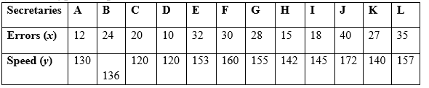
14. The table below shows the speeds(y) in seconds and the number of errors(x) in the typed scripts of 12 secretaries of a certain institution
Construct a scatter diagram, draw the line of best fit and use it to estimate x when y= 142 seconds
Giving rank 1 to the fastest secretary and the secretary with the fewest errors, calculate the rank correlation coefficient and comment at 5% level of significance

Slide 23
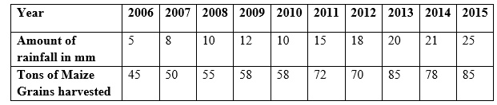
15.The table below shows the amount of rainfall(mm) and tonnes of maize produced by farmers’ forum from 2019 to 2020
#
Plot a scatter graph for the above data and comment on your graph
Draw a line of best fit and use it to estimate the rain fall needed to have an out put of 100 tonnes given other factors remain constant
Calculate the rank correlation coefficient .comment at 1% level of significance

Slide 24
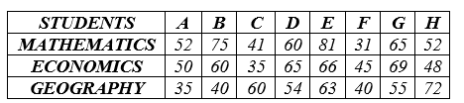
16. The marks of 8 students in maths ,geography and economics were as follows
#
a) Calculate the rank correlation coefficient for the student’s performance in:
(i) mathematics and Economics.
(ii) mathematics and Geography.
b) Comment on the significance of mathematics in the performance of Economics
and Geography at 1% level of significance

